Slide 1

DroidScope
Seamlessly Reconstructing the OS and Dalvik Semantic Views for Dynamic Android Malware Analysis
Lok Yan, Heng Yin
August 10, 2012, 21st USENIX Security Symposium

Slide 2
Outline
Introduction
Background
DroidScope
  Architecture
  OS - Level View
  Dalvik - Level View
Interface & Plugins
Evaluation
Demo
Challenges

Slide 3

Introduction
Samsung sold 350+ million phones in 2012.
Android's open market became a hotspot for attackers.
Malicious apps frequently uploaded to Android Market.
Real-time testing is vital due to malware code concealment.
Virtual systems commonly used to study unauthorized actions.
Notes:
Android is a popular mobile operating system that is installed in millions of devices.
The popularity of Android and the open nature of its application marketplace makes it a prime target for attackers.
Malware authors can freely upload malicious applications to the Android Market waiting for unsuspecting users to download and install them.
Studying malware and finding security flaws on computers is thorough. Everyone agrees that real-time testing is crucial as malware often hides its code to block simple inspection.
A lot of research has used virtual systems, like software copies or physical hardware copies, to examine and study unauthorized actions within those virtual environments.

Slide 4
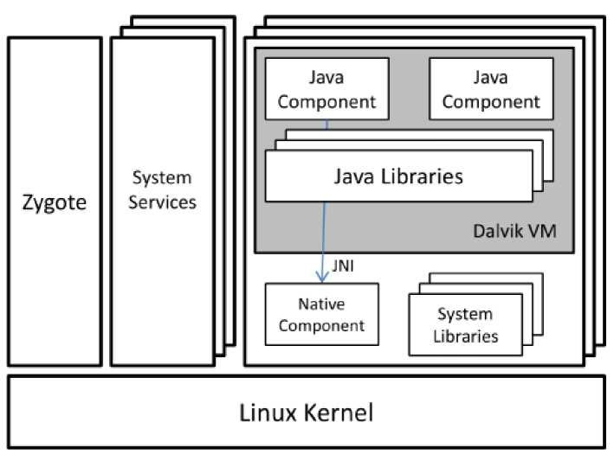
Introduction

Slide 5
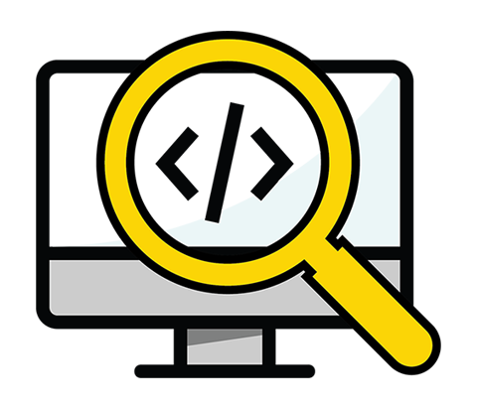
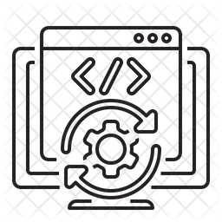

Background
Static Code Analysis
(Proguard, Android SDK)
Dynamic Code Analysis
(adb, logcat)
Virtualization Based Analysis
Notes:
Static Analysis – like code analysis before the deployment
Dynamic Analysis – analysis when app is running but malware can detect this and stop the analysis runtime
Droidscope uses Virtualization-based analysis approach.
Analysis runs underneath the entire virtual machine
Difficult for an attack within VM to disrupt the analysis

Slide 6
DroidScope
Reconstruct two levels of semantic knowledge
  OS-level: to understand the activities of the malware process and its native components.
  Java-level: comprehend the behaviors in the Java components.
Built on top of QEMU emulator.
Build tools for analysis
  Native instruction tracer
  Dalvik instruction tracer
  API tracer
  Taint tracker
Notes:
It is a malware analysis platform specially designed for Android operating system, aiming to understand and counteract Android Malware.
It operates by dynamically analyzing malware within a virtualized environment
It can reconstructs the semantic knowledge at two levels –
1. OS-level semantics that understand the activities of the malware process and its native components
2. Java-level semantics that comprehend the behaviors in the Java components.

Slide 7
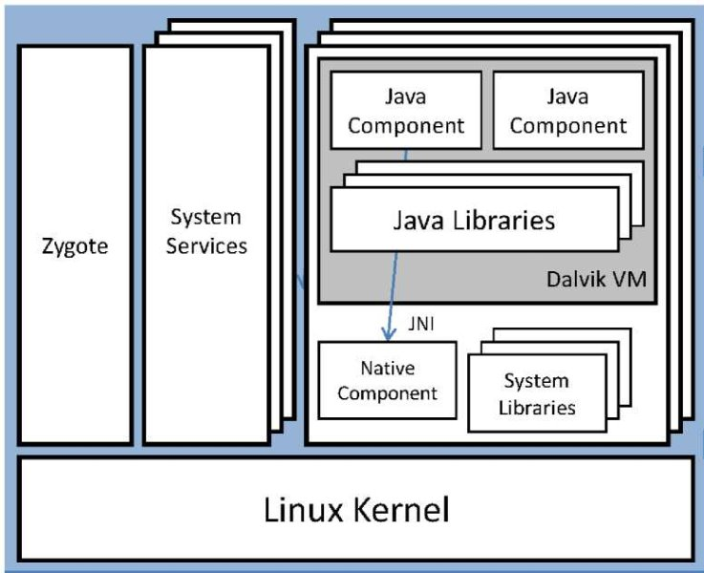
DroidScope Architecture
Instrumentation Interface
API Tracer
Native Insn. Tracer
Dalvik Insn. Tracer
Taint Tracker
DroidScope
Notes:
It is a malware analysis platform specially designed for Android operating system, aiming to understand and counteract Android Malware.
It operates by dynamically analyzing malware within a virtualized environment
It can reconstructs the semantic knowledge at two levels –
1. OS-level semantics that understand the activities of the malware process and its native components
2. Java-level semantics that comprehend the behaviors in the Java components.
Integrating the changes into the QEMU emulator
Came from Android SDK
Leave Android system unchanged
For different virtual devices can be loaded
Reconstruct OS-level and Java-level views
Monitors how malware’s Java components communicate with Android Java Framework
Monitors how malware’s native components interact with the Linux Kernel
Monitors how malware’s Java components and native components communicate through the JNI interface

Slide 8

OS-Level View
Application
System Services & File System
DroidScope
Hardware Emulation
Image Format
Host OS Kernal
Notes:
QEMU (Quick Emulator) is a generic and open source machine emulator and virtualizer.
When used as a machine emulator, QEMU can run OSes and programs made for one machine (e.g. an ARM board) on a different machine (e.g. your own PC). By using dynamic translation, it achieves very good performance
The Android Emulator uses the Quick Emulator (QEMU) hypervisor.
Initial versions of the Android Emulator used QEMU 1 (goldfish), and later versions use QEMU 2 (ranchu).

Slide 9
OS-Level View
Disassemble guest instructions
Android OS
Translate to TCG
(Tiny Code Generator)
System Calls
Compile to host instruction
Processes and Threads
Shadow task list – pid, uid, gid, etc.
QEMU
Insert extra TCG instr. During translation
DroidScope
Monitor system control co-processor writes
Memory Map
Address space layout
sys_mmap2 ()
Linux Kernal (Host)
Execute Translated Code Block
Use code cache for subsequent executions
Analysis & Data Extraction
QEMU Execution Flow
Notes:
QEMU (Quick Emulator) is a generic and open source machine emulator and virtualizer.
When used as a machine emulator, QEMU can run OSes and programs made for one machine (e.g. an ARM board) on a different machine (e.g. your own PC). By using dynamic translation, it achieves very good performance
The Android Emulator uses the Quick Emulator (QEMU) hypervisor.
Initial versions of the Android Emulator used QEMU 1 (goldfish), and later versions use QEMU 2 (ranchu).

Slide 10





Semantic View Reconstruction – Dalvik View
Notes:
Execution of Dalvik Bytecode Instructions: The DVM (Dalvik Virtual Machine) executes Dalvik bytecode, which is essentially the instruction set of the Android applications. These instructions are then translated into machine code that can be executed by the device's processor.
Interception of Dalvik Bytecode Execution: DroidScope intercepts the execution of Dalvik bytecode. This interception allows DroidScope to analyze what instructions are being executed and to translate these into a form that can be examined for various aspects, such as security analysis or performance evaluation.
Translation to Register-Level Representation: The intercepted instructions are translated to a register-level representation. This means that the high-level bytecode instructions are broken down into low-level operations that work with the CPU's registers. This translation is critical for a deeper understanding of how the application interacts with the hardware and the operating system.
API Call Monitoring: API calls made by the application are monitored. APIs are the interface through which applications communicate with the operating system and other software. By monitoring these calls, DroidScope can track the behavior of the application, such as network communication, file access, and interaction with other applications or services.
Taint Analysis: Taint analysis is used to track the flow of sensitive information through the application. By marking data as "tainted," DroidScope can follow it as it moves through different variables, methods, and data structures within the application. This is particularly useful for identifying potential security vulnerabilities, such as information leaks or unauthorized access to sensitive data.

Slide 11

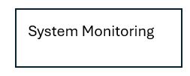



Interface & Plugins
Notes:
System Monitoring API:
This API is designed for the observation of system-level behavior.
It allows for the tracking of system calls, which are the mechanisms used by applications to request services from the operating system's kernel.
By tracking system calls and their arguments, the API can log detailed activities of the application such as file access, network communication, and inter-process communication.
This information is critical in understanding the actions taken by an application, especially when evaluating potentially malicious behavior.
Dalvik VM Inspection API:
This API is specifically targeted at inspecting the Dalvik Virtual Machine (DVM), which is Android’s runtime environment for apps.
It can monitor the execution of Dalvik bytecode instructions, which are the operations that the DVM interprets to run Android applications.
Inspection can reveal the flow of execution within an app, show method invocations, object creations, and exceptions.
This is key for understanding the higher-level logic of an application, separate from system-level interactions.
Reconstruction API:
The Reconstruction API allows DroidScope to reconstruct high-level semantic views from the observed low-level events.
It translates the raw events captured by the system monitoring and Dalvik VM inspection APIs into a form that is understandable and meaningful for analysis.
For instance, it can reconstruct the sequence of method calls and data accesses within an app, which can then be mapped back to the app’s source code.
This reconstructed view is crucial for malware analysts to understand the intention behind the code and to identify potential security issues.
Custom Analysis API:
This API provides the flexibility to implement custom analysis tools on top of the DroidScope framework.
It allows analysts to build tailored solutions that can address specific analysis needs or focus on certain types of behavior.
With this API, users can extend the functionality of DroidScope, such as adding new forms of taint tracking, integrating with other analysis tools, or developing new heuristics for detecting malware.
The custom analysis API ensures that DroidScope can adapt to the evolving landscape of Android malware.

Slide 12









Interface & Plugins
Notes:
TaintTracker:
TaintTracker is used for conducting taint analysis, which is a method of tracking the flow of data through an application to identify how sensitive information, such as passwords or personal data, is processed and where it may be inadvertently leaked.
When data is marked as 'tainted,' TaintTracker monitors how this data propagates through variables, method calls, and other data structures. It is especially useful for discovering security vulnerabilities that could lead to information leakage, such as buffer overflows or insecure data transmissions.
TaintTracker can identify both direct flows of information (where data is passed without modification) and indirect flows (where data is transformed or combined with other data).
IntruScope:
IntruScope is designed for detailed, instruction-level monitoring and logging of an application's execution. It provides insights into the exact operations performed by an app, down to the level of individual CPU instructions.
It enables fine-grained analysis that can uncover hidden behaviors in malware, such as unpacking routines, obfuscation mechanisms, or the execution of payload activities.
This plugin can be instrumental in reverse-engineering malware to understand its infection vector, replication mechanism, and how it performs malicious activities.
APIMonitor:
APIMonitor specializes in tracking API calls made by an application, which are key points of interaction between the app and the Android operating system.
By monitoring these calls, APIMonitor provides visibility into how an app is utilizing system resources, interacting with hardware components, and communicating with other apps or servers.
This plugin can detect unauthorized access to resources, identify potential privacy violations, and track network communication that could indicate data exfiltration or command-and-control activity.
NativeBridge:
NativeBridge is focused on the analysis of native code execution within an Android application. Native code refers to code written in languages like C or C++ and compiled to run directly on the processor, as opposed to bytecode executed by the Dalvik VM.
This plugin is crucial for analyzing parts of an app that may be implemented in native code for performance reasons or to evade detection, as many analysis tools focus only on Dalvik bytecode.
NativeBridge can provide insights into performance optimizations, as well as potentially malicious activities that are harder to analyze or detect in the Dalvik bytecode, such as exploits against the operating system or obfuscated malware payloads.

Slide 13
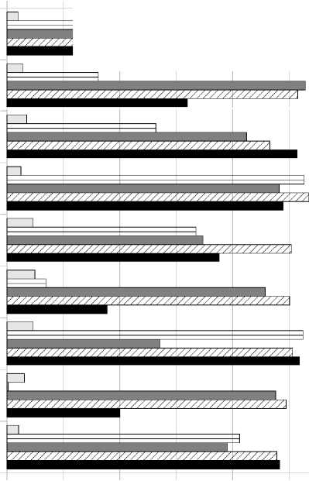
Evaluation
Percent of Baseline
0% 20% 40% 60% 80% 100%
• Seven free benchmark Apps
— AnTuTu Benchmark
— (ABenchMark) by AnTuTu
— CaffeineMark by Ravi Reddy
— CF-Bench by Chainfire
— Mobile processor benchmark (Multicore) by Andrei Karpushonak
— Benchmark by Softweg
— Linpack by GreeneComputing
• Six tests repeated five times each
— Baseline
— NO-JIT Baseline - uses a build with JIT disabled at runtime
— Context Only
— API Tracer
— Dalvik Instruction Trace
Linpack/Multithread Linpack/Singlethread Multicore (ms) CPUBench (ms) CFBench/Overall CFBench/Java CFBench/Native CaffieneMark ABenchMark
0% 20% 40% 60% 80% 100%
Percent of Baseline
■ NOJIT Baseline E3 Context Only □ API Tracer B Dalvik □ Taint Tracker
Instruction Tracer
Notes:
Evaluation Setup:
Seven Benchmark Apps: These are applications specifically designed to measure the performance of mobile devices. They test various aspects like processing power, memory efficiency, and multitasking capabilities.
Six Tests: Each benchmark app was run five times to ensure the results were consistent. This repetition helps to average out any irregularities and provides a more reliable measure of performance.
Different Configurations Tested:
Baseline: The normal speed of the benchmarks without any analysis tools running. This sets the standard for comparison.
NO-JIT Baseline: The speed with JIT (Just-In-Time compilation) disabled. JIT is a system that can make apps run faster by compiling them as they’re being used, rather than beforehand. Disabling it typically slows things down, which shows how much of an impact JIT has.
Context Only: How much the system monitoring component of the analysis tool affects performance.
API Tracer: The performance impact when API calls are being tracked.
Dalvik Instruction Trace: The overhead caused by detailed tracing of Dalvik VM instructions.
Taint Tracker: The slowdown caused by tracking the flow of sensitive information to check for leaks.
Understanding the Chart:
The chart shows the relative performance of each tool compared to the baseline (full speed with no tools running).
For instance, if a benchmark shows a score of 80% of baseline under "API Tracer," it means the app ran 20% slower than normal when API calls were being traced.
Ideally, you want the performance to be close to 100% of baseline, meaning there's little to no slowdown.
The annotations point out that API Tracer performance is closer to the NO-JIT baseline rather than the full baseline, and the chart also suggests that results may vary (they are "not perfect") and that retrieving symbols dynamically to aid analysis can also add overhead (slow things down).

Slide 14



Evaluation
Effectivness
It provides a unified interface for analyzing Dalvik bytecode and native instructions, effectively revealing malware behaviors as demonstrated with DroidKungFu and DroidDream.
Semantic information
DroidScope is a dynamic binary instrumentation tool for Android that captures detailed semantic information from both operating system and Java levels without altering the guest system.
Performance
The tool maintains system integrity with JIT compilation intact and has been evaluated to perform reasonably well, especially when JIT is selectively disabled for targeted analysis like API tracing.
Notes:
Effectiveness:
DroidScope offers a comprehensive tool that can analyze both the high-level Java code and the lower-level native instructions. This is key for a thorough investigation of potential malware, as seen in the cases of DroidKungFu and DroidDream.
The "unified interface" means it has a single dashboard or point of control for examining different aspects of apps, which streamlines the process of identifying suspicious or malicious behavior.
Semantic Information:
It captures in-depth information about how an app interacts with the Android system (OS-level) as well as how the app's own code operates (Java-level), all without making any changes to the system being analyzed. This is important because it doesn't disrupt normal device operations or alert malware to the fact that it's being watched.
The term "dynamic binary instrumentation" refers to the tool's ability to inspect and modify the running app's code on the fly, which allows for real-time analysis and response.
Performance:
DroidScope is designed to work with the system's Just-In-Time (JIT) compilation process, which is a performance feature of Android that compiles apps as they run for faster execution. By not disrupting this feature, DroidScope ensures that apps can still run efficiently while under analysis.
The performance evaluations indicate that the tool can be fine-tuned, such as disabling JIT when necessary, to minimize its impact on app performance, making it a viable option for use in various scenarios without significantly slowing down the device.

Slide 15
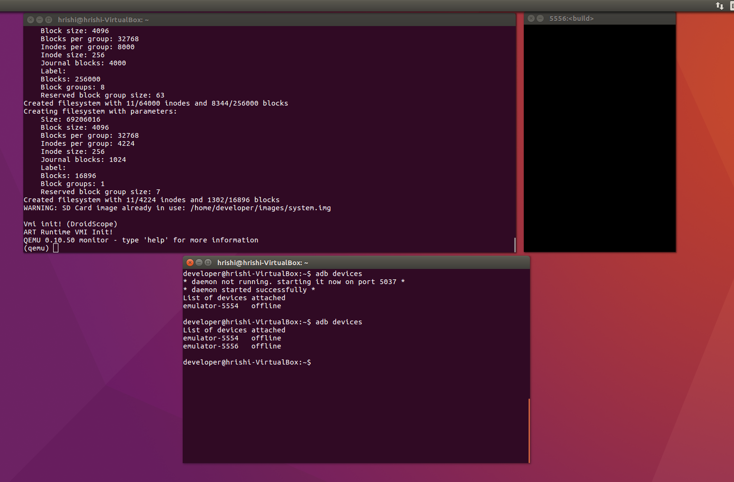
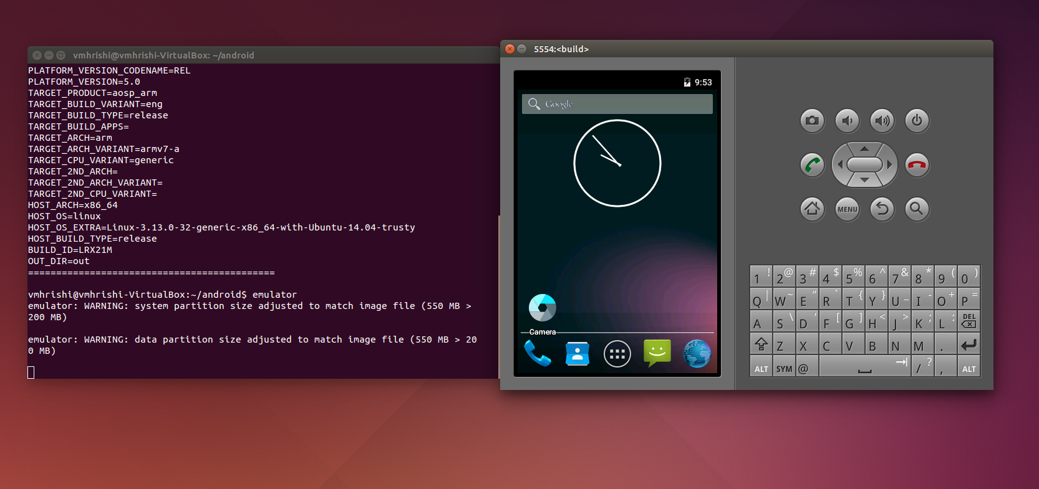
Demo

Slide 16
Challenges
DroidScope was developed between 2012 and 2016, with updates continuing through 2019.
The GitHub repository specified the following requirements:
  Ubuntu 14.04 for Android build / 16.04 for Droidscope
  A build of Android 5 with the Goldfish kernel from the Android Open Source Project
DroidScope utilized certain files and system images from the build for operation.
It was designed for a 32-bit operating system.
Initially, we encountered limitations using Android apps because we managed our operations through Docker / Virtual Box.

Slide 17
Thank You

